Slide 1
Configure a Network Policy Server Infrastructure

Slide 2
Outline
Plan Network Policy Server
Configure Network Policy Server
Manage Network Policy Server

Slide 3
What are network policies?
Network policies are sets of conditions, constraints, and settings that allow you to designate who is authorized to connect to the network and the circumstances under which they can or cannot connect.
Network policy is a collection of rules that govern the behaviors of network devices.
https://docs.microsoft.com/ms-my/windows-server/networking/technologies/nps/nps-np-overview

Slide 4
Network Policies in Windows
Network Policy Server (NPS) allows you to create and enforce organization-wide network access policies for connection request authentication and authorization.
Network Policies - An Ordered Set of Rules
Each rule has a set of conditions and settings.
NPS compares the conditions of the rule to the properties of connection requests.
If a match occurs between the rule and the connection request, the settings defined in the rule are applied to the connection.

Slide 5
Network Policies in Windows
The primary purpose of a network security policy is to inform users and staff the requirements for protecting various assets.
These assets take many forms, including passwords, documents, or even servers.
These policies also lay guidelines for acquiring, configuring, and auditing computer systems and networks.

Slide 6
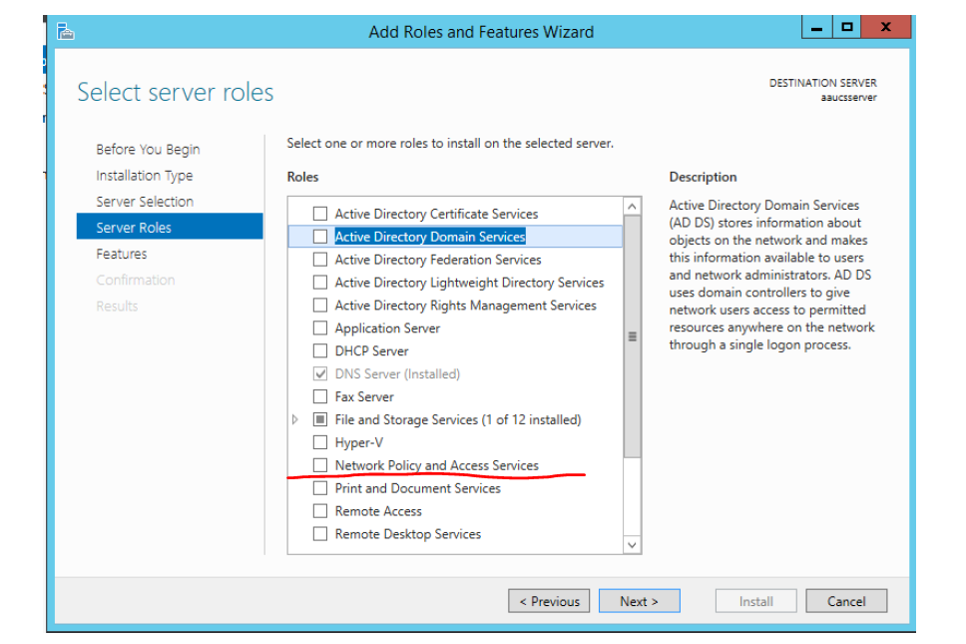
Overview of Network Policy Server (NPS)
in Windows Server 2016 and Windows Server 2019.
NPS is installed when you install the Network Policy and Access Services (NPAS) feature in Windows Server 2016 and Server 2019.
In Server Manager, select Tools, and then select Network Policy Server. The NPS console opens. In the NPS console, right-click NPS (Local), then select Register server in Active Directory. The Network Policy Server dialog box opens
https://www.youtube.com/watch?v=GSAClWmg8y0

Slide 7
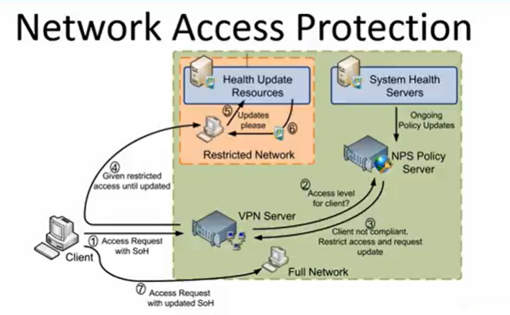
Network Policy and Access Services (NPAS) is used to provide secure remote access.
This access is provided via a few different methods.
NPAS is used to deploy RADIUS, Network Access Protection (NAP), and secure access points.

Slide 8
Network Policy Server (NPS) Applies to: Windows Server (Semi-Annual Channel), Windows Server 2016, Windows Server 2019
Network Policy Server (NPS) - to create and enforce organization-wide network access policies for connection request authentication and authorization.
Configure NPS as a Remote Authentication Dial-In User Service (RADIUS) proxy to forward connection requests to a remote NPS or other RADIUS server so that it can load balance connection requests and forward them to the correct domain for authentication and authorization.

Slide 9
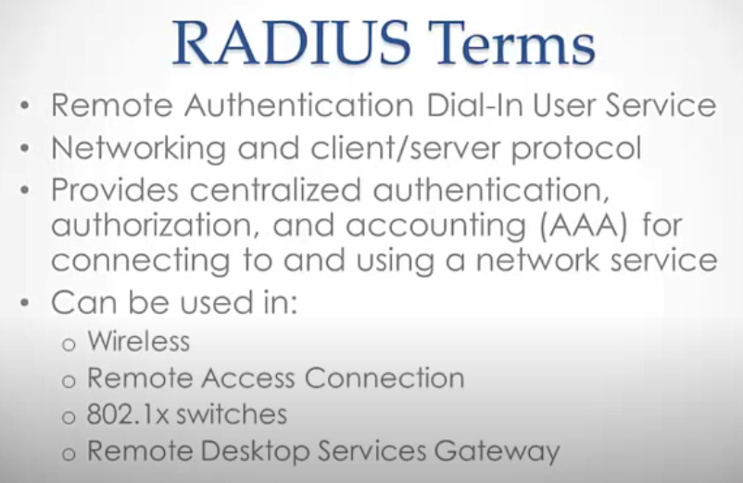
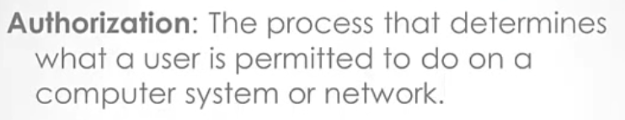
https://www.youtube.com/watch?v=ZdQqIKoesas

Slide 10
Plan Network Policy Server
Plan NPS as a RADIUS server
Plan NPS as a RADIUS proxy

Slide 11
Network Policy Server (NPS)
NPS allows centrally configure and manage network access authentication, authorization, and accounting with the following features:
RADIUS server.
NPS performs centralized authentication, authorization, and accounting (AAA) for wireless, authenticating switch, remote access dial-up and virtual private network (VPN) connections.
When NPS used as a RADIUS server, configure network access servers, such as wireless access points and VPN servers, as RADIUS clients in NPS.
Also, configure network policies that NPS uses to authorize connection requests, and can configure RADIUS accounting so that NPS logs accounting information to log files on the local hard disk or in a Microsoft SQL Server database.

Slide 12
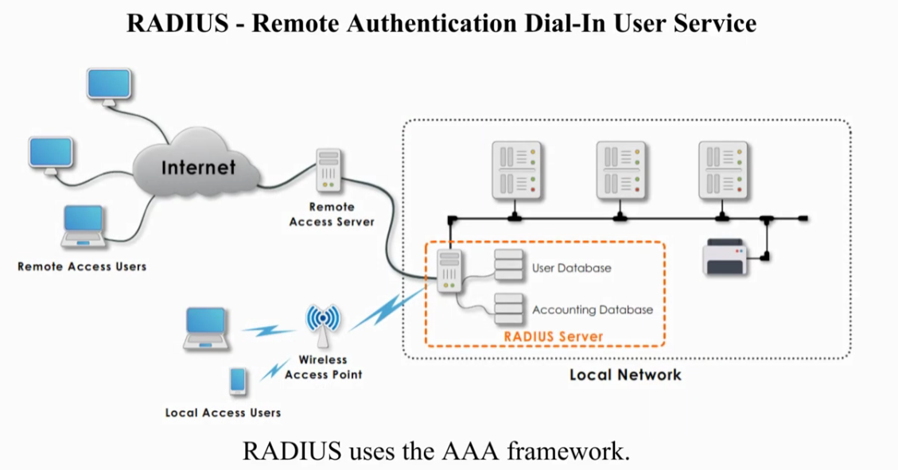
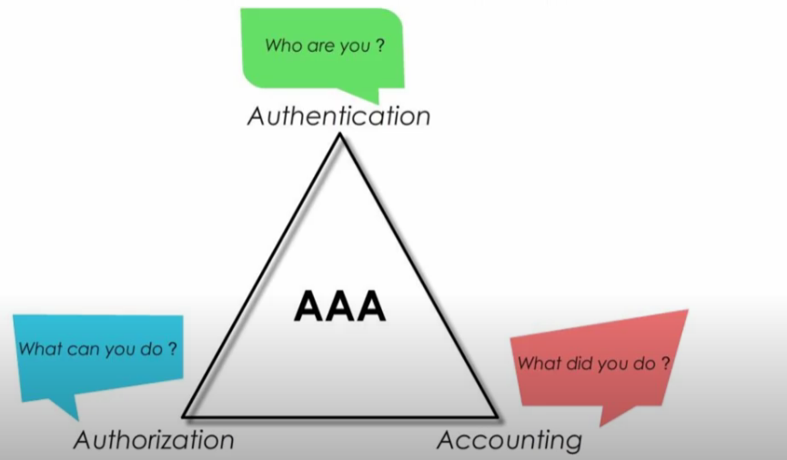
https://www.youtube.com/watch?v=feHpDc1cLXM

Slide 13
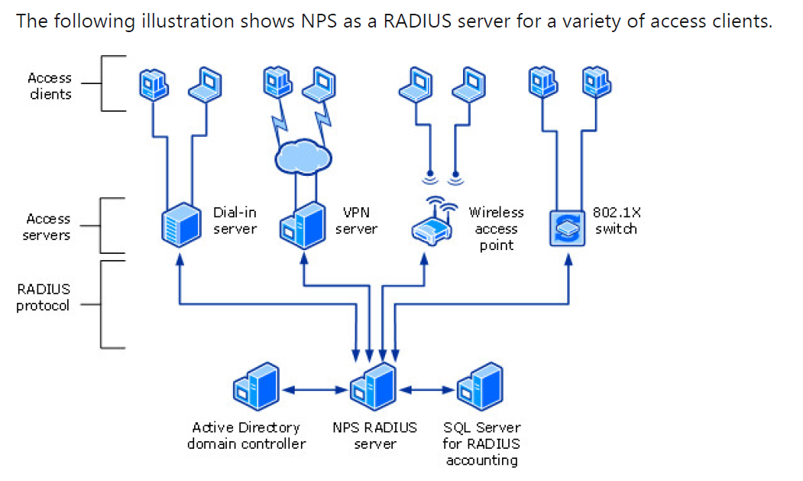
You can use NPS as a RADIUS server when:
You are using an AD DS domain or the local Security Access Manager (SAM) user accounts database as your user account database for access clients.
You are using Remote Access on multiple dial-up servers, VPN servers, or demand-dial routers and you want to centralize both the configuration of network policies and connection logging and accounting.
You are outsourcing your dial-up, VPN, or wireless access to a service provider. The access servers use RADIUS to authenticate and authorize connections that are made by members of your organization.
You want to centralize authentication, authorization, and accounting for a heterogeneous set of access servers.
* The Security Account Manager (SAM)
Ref: https://docs.microsoft.com/en-us/windows-server/networking/technologies/nps/nps-top
https://www.youtube.com/watch?v=ZdQqIKoesas

Slide 14
Point-to-Point Protocol (PPP) Authentication protocols
PAP stands for Password Authentication Protocol. PAP, on the end-user side, works as we all readily understand. For example: the user inputs a username and password. That information is provided by the user to the client who then sends it from the network access server (NAS) to the RADIUS server. Unfortunately, PAP is terribly insecure because it sends both the username and password in plaintext, meaning that anybody who has the ability to intercept packets between the NAS and RADIUS server would be able to discern the username and password easily.
CHAP stands for Challenge Handshake Authentication Protocol. It is a more secure method of authentication than PAP (although it wasn’t hard to be more secure than a clear-text password communication).
CHAP eliminates the process of sending clear-text passwords and instead utilizes encryption to mask the information being transferred.
https://www.professormesser.com/security-plus/sy0-501/pap-chap-and-ms-chap/

Slide 15
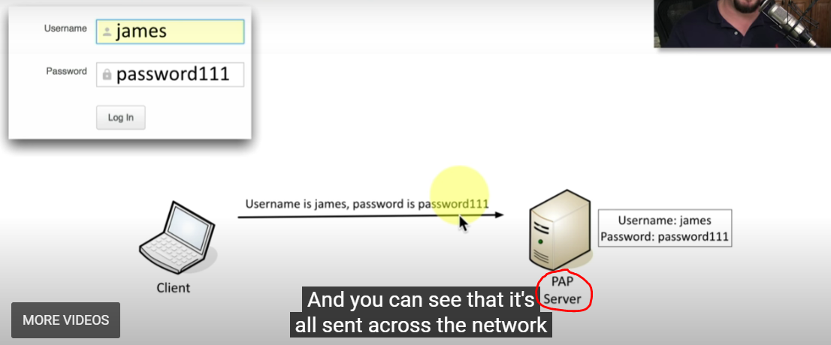
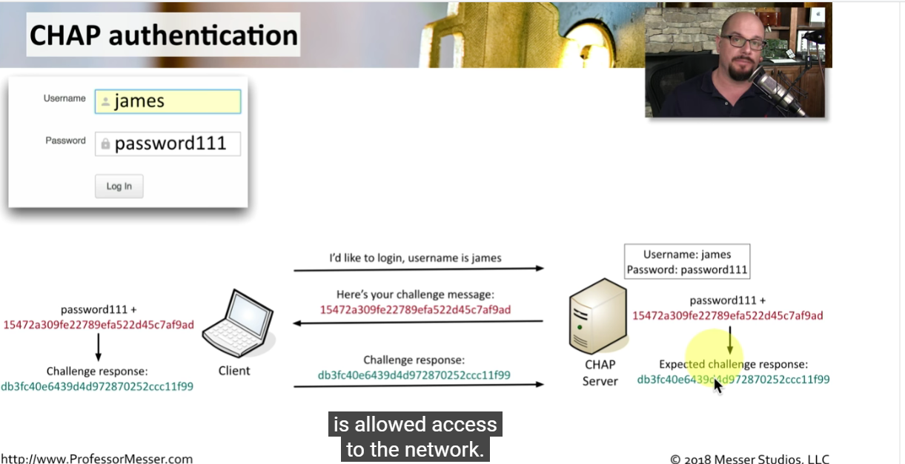
PAP VS CHAP
https://www.professormesser.com/security-plus/sy0-501/pap-chap-and-ms-chap/

Slide 16
In computer networking, Point-to-Point Protocol (PPP) is a Data link layer (layer 2) communications protocol between two routers directly without any host or any other networking in between.
It can provide connection authentication, transmission encryption, and compression.

Slide 17
Network Policy Server (NPS)
RADIUS proxy.
Use NPS as a RADIUS proxy when:
a service provider who offers outsourced dial-up, VPN, or wireless network access services to multiple customers.
to provide authentication and authorization for user accounts that are not members of either the domain
to perform authentication and authorization by using a database that is not a Windows account database.
to process a large number of connection requests.
to provide RADIUS authentication and authorization for outsourced service providers and minimize intranet firewall configuration.

Slide 18
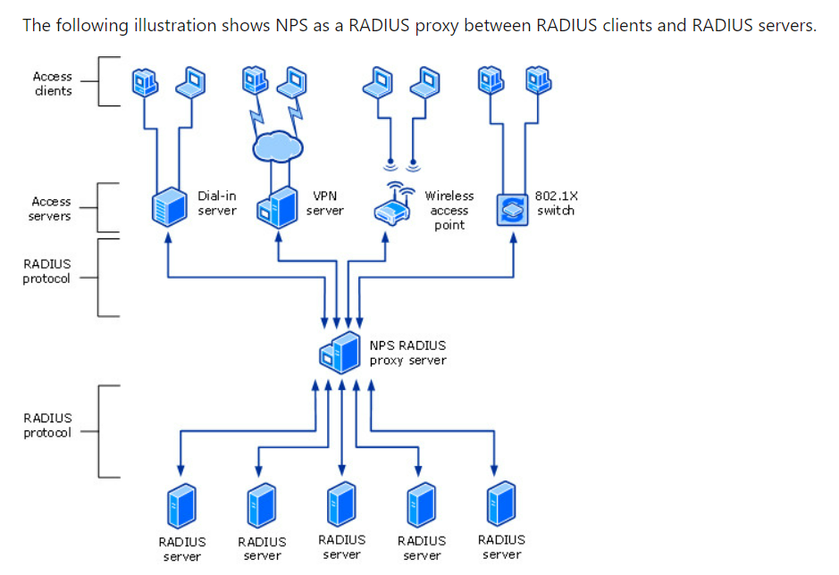

Slide 19
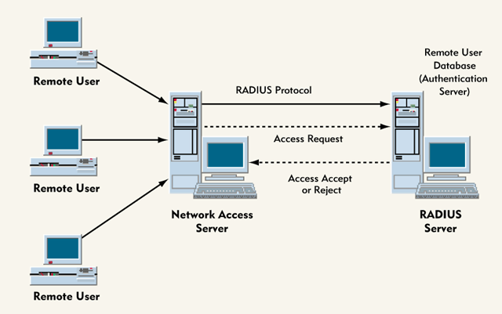
RADIUS is a client server protocol that enable network access server (NAS) to communicate with central server to authentic dial-in user, authorize their access to the network and keep track of their activities.
Ref: https://forum.huawei.com/enterprise/en/how-to-configure-the-radius-authentication/thread/450231-861

Slide 20
Network Policy Server (NPS)
With NPS, organizations can also outsource remote access infrastructure to a service provider while retaining control over user authentication, authorization, and accounting.
NPS configurations can be created for the following scenarios:
Wireless access
Organization dial-up or virtual private network (VPN) remote access
Outsourced dial-up or wireless access
Internet access
Authenticated access to extranet resources for business partners

Slide 21
Plan NPS as a RADIUS server
Guidelines to deploy NPS as a RADIUS server on the network
Plan NPS configuration.
Plan RADIUS clients.
Plan the use of authentication methods.
Plan network policies.
Plan NPS accounting.
Ref: https://docs.microsoft.com/en-us/windows-server/networking/technologies/nps/nps-plan-server

Slide 22
Plan NPS as a RADIUS proxy
Guidelines to deploy NPS as a RADIUS proxy on the network
Plan NPS configuration.
Plan RADIUS clients.
Plan remote RADIUS server groups.
Plan attribute manipulation rules for message forwarding.
Plan connection request policies.
Plan NPS accounting.
** Accounting relate to monitoring network resources, information needed for billing of services
Ref: https://docs.microsoft.com/en-us/windows-server/networking/technologies/nps/nps-plan-proxy

Slide 23
Configure Network Policy Server
Deploy NPS Certificates for VPN and 802.1X Access
Deploy NPS for 802.1X Wireless Access
Deploy NPS for Windows 10 VPN Access

Slide 24
Manage Network Policy Server
Network Policy Server Management with Administration Tools
Configure Connection Request Policies
Configure Firewalls for RADIUS Traffic
Configure Network Policies
Configure Network Policy Server Accounting
Configure RADIUS Clients
Configure Remote RADIUS Server Groups
Manage Certificates Used with NPS
Manage NPSs
Manage NPS Templates

Slide 25
Network Policy Server Management with Administration Tools
Configure the Local NPS by Using the NPS Console
Manage Multiple NPSs by Using the NPS MMC Snap-in
Manage an NPS by Using Remote Desktop Connection
Use Netsh NPS commands to manage an NPS
Use Windows PowerShell to manage NPSs

Slide 26
Configure Connection Request Policies
Add a Connection Request Policy
Membership in Domain Admins, or equivalent, is the minimum required to complete this procedure.

Slide 27
Configure Firewalls for RADIUS Traffic
Windows Firewall on the local NPS
Other firewalls
Configuring the Internet firewall

Slide 28
Configure Network Policies
Add a Network Policy
Create Network Policies for Dial-Up or VPN with a Wizard
Create Network Policies for 802.1X Wired or Wireless with a Wizard
Configure NPS to Ignore User Account Dial-in Properties
Configure NPS for VLANs
Configure the EAP Payload Size

Slide 29
Configure Network Policy Server Accounting
There are three types of logging for Network Policy Server (NPS):
Event logging. Used primarily for auditing and troubleshooting connection attempts. Configure NPS event logging by obtaining the NPS properties in the NPS console.
Logging user authentication and accounting requests to a local file. Used primarily for connection analysis and billing purposes. Also useful as a security investigation tool because it provides a method of tracking the activity of a malicious user after an attack. Configure local file logging using the Accounting Configuration wizard.
Logging user authentication and accounting requests to a Microsoft SQL Server XML-compliant database. Used to allow multiple servers running NPS to have one data source. Also provides the advantages of using a relational database. Configure SQL Server logging by using the Accounting Configuration wizard.

Slide 30
Configure Network Policy Server Accounting
Use the Accounting Configuration wizard
Configure NPS Log File Properties
Configure NPS SQL Server Logging
Ping user-name

Slide 31
Configure RADIUS Clients
On the NPS proxy, configure a remote RADIUS server group that contains the NPS.
On the remote NPS, configure the NPS proxy as a RADIUS client.
To perform the procedures in this topic, must have at least one network access server (VPN server, wireless access point, authenticating switch, or dial-up server) or NPS proxy physically installed on the network.
Configure the Network Access Server
Add the Network Access Server as a RADIUS Client in NPS
Configure RADIUS Clients by IP Address Range in Windows Server 2016 Datacenter

Slide 32
Configure Remote RADIUS Server Groups
Add a Remote RADIUS Server Group
Create a new connection request policy that NPS uses to determine which connection requests to forward to other RADIUS servers.
In addition, the connection request policy is configured by specifying a remote RADIUS server group that contains one or more RADIUS servers, which tells NPS where to send the connection requests that match the connection request policy.

Slide 33
Manage Certificates Used with NPS
Enroll a server certificate to all NPSs. The server certificate must:
Meet the minimum server certificate requirements as described in Configure Certificate Templates for PEAP and EAP Requirements
Be issued by a certification authority (CA) that is trusted by client computers. A CA is trusted when its certificate exists in the Trusted Root Certification Authorities certificate store for the current user and local computer.
Change the Cached TLS Handle Expiry
Configure the TLS Handle Expiry Time on Client Computers
Configure the TLS Handle Expiry Time on NPSs
Obtain the SHA-1 Hash of a Trusted Root CA Certificate

Slide 34
Manage NPSs
Configure NPS on a Multihomed Computer
Configure NPS UDP Port Information
Disable NAS Notification Forwarding
Export an NPS Configuration for Import on Another Server
Increase Concurrent Authentications Processed by NPS
Install Network Policy Server
NPS Proxy Server Load Balancing
Register an NPS in an Active Directory Domain
Unregister an NPS from an Active Directory Domain
Use Regular Expressions in NPS
Verify Configuration After NPS Changes

Slide 35
Manage NPS Templates
Templates Management provides a node in the NPS console where you can create, modify, delete, duplicate, and view the use of NPS templates. NPS templates are designed to reduce the amount of time and cost that it takes to configure NPS on one or more servers.
The following NPS template types are available for configuration in Templates Management.
Shared Secrets. To specify a shared secret that can reuse (by selecting the template in the appropriate location in the NPS console) when configure RADIUS clients and servers.
RADIUS Clients. To configure RADIUS client settings that can reuse by selecting the template in the appropriate location in the NPS console.
Remote RADIUS Servers. To configure remote RADIUS server settings that can reuse by selecting the template in the appropriate location in the NPS console.
IP Filters. To create Internet Protocol version 4 (IPv4) and Internet Protocol version 6 (IPv6) filters that can reuse (by selecting the template in the appropriate location in the NPS console) when configure network policies.
Create an NPS Template
Apply an NPS Template
Export or Import NPS Templates

Slide 36
After install NPS, administer NPSs via:
Locally, by using the NPS Microsoft Management Console (MMC) snap-in, the static NPS console in Administrative Tools, Windows PowerShell commands, or the Network Shell (Netsh) commands for NPS.
From a remote NPS, by using the NPS MMC snap-in, the Netsh commands for NPS, the Windows PowerShell commands for NPS, or Remote Desktop Connection.
From a remote workstation, by using Remote Desktop Connection in combination with other tools, such as the NPS MMC or Windows PowerShell.

Slide 37

The End

